Slide 1
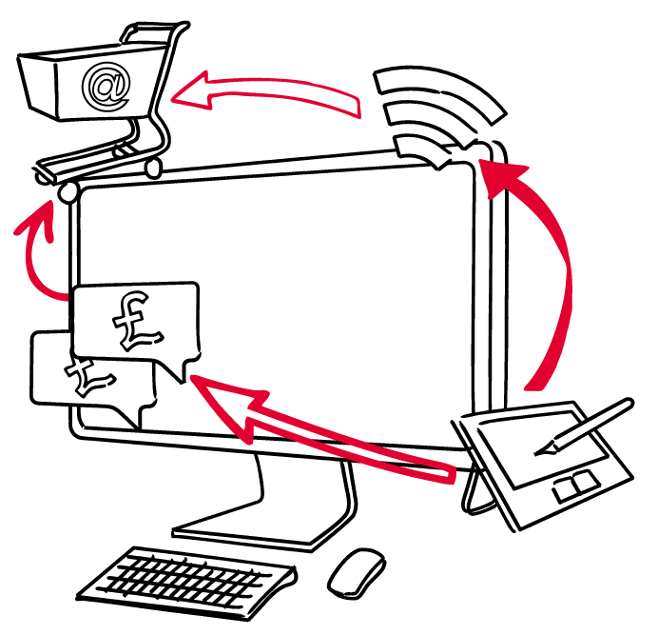
Transformational ICT
Pay On Performance (POP) Marketing
Ann Stanley
Anicca Solutions

Slide 2
Agenda
An introduction to Pay On Performance or POP marketing
An overview of the main POP techniques
Affiliate marketing
  What is affiliate marketing?
  Examples of affiliate websites
  Setting up an affiliate program
  Product feeds and syndication
  Drop shipping, white label websites and market places
Lead generation for B2B and services
Daily deals

Slide 3
Definition of POP marketing
Pay on Performance (POP) marketing is:-
Where a third party generates sales or leads for the seller or service provider and only gets paid on performance (i.e. receives a commission for each successful sale or lead)
Also called pay for performance, performance marketing, pay on results
Sometimes used to describe other types of marketing such as pay on results based search engine optimisation

Slide 4
Benefits of POP marketing
You only pay on performance i.e. when a sale is made or a lead is generated
Additional routes to market - other people do the marketing for you (often called affiliates)
Gain new customers at low cost
  Often no or low start-up or upfront costs
  Often cheaper than PPC
  Faster than SEO
Ability to target certain types of customers e.g. by location
NOTE: You can also become an affiliate and earn extra income from your site or marketing activities

Slide 5
Main types of POP marketing
Affiliate marketing (including some shopping directories, incentive and loyalty sites)
Product feeds and syndication (including drop shipping, white label websites and market places)
Lead generation sites
Daily deals
You take the money | 3rd party takes the money
Affiliate marketing Product syndication Lead generation sites | Drop shipping White label websites Market places Daily deals

Slide 6
Sales of products – routes to market
 | DIY Marketing & sales | Affiliate marketing | Product syndication | Drop shipping | Daily Deals | Stockists & resellers
Marketing by | Seller | 3rd party | 3rd party | 3rd party | 3rd party | 3rd party
Money taken by | Seller | Seller | Seller | 3rd party | 3rd party | 3rd party
Product supplied by | Seller | Seller | Seller | Seller | Seller | 3rd party
Techniques used | Sellers Ecommerce website | Banners and ads linking to sellers website | 3rd party Ecommerce website with links back to sellers site | 3rd party Ecommerce website with own payments | Daily email Referrals 3rd party Website takes payments | 3rd party Ecommerce Website with own payments Buys and holds stock

Slide 7
Sales of services – routes to market
 | DIY Marketing | Affiliate marketing | Lead generation | Daily Deals | Agents
Marketing by | Seller | 3rd party | 3rd party | 3rd party | 3rd party
Money taken by | Seller | Seller | Seller | 3rd party | 3rd party
Product supplied by | Seller | Seller | Seller | Seller | Seller or 3rd party
Techniques used | Sellers website | Banners and ads linking to sellers website | 3rd party Lead generation website | Daily email Referrals 3rd party Website takes payment | 3rd party Website

Slide 8
Affiliate Marketing
Affiliate marketing

Slide 9
What is Affiliate Marketing?
Affiliate marketing is:-
Where a third party (or Affiliate) generates sales or leads for the seller (or Merchant) and receives a commission for each successful sale or lead
It is probably the most widespread form of POP marketing
There are two parties in affiliate marketing the merchant and the affiliate - which applies to you?

Slide 10
Merchants (sellers or service provider)
Merchants include both smaller businesses and large multi-national companies
Affiliate marketing works very well for certain types of Merchants
  New businesses (with no SEO traffic)
  Companies with low budgets or where the cost per acquisition is expensive by using other methods (such as pay per click)
  Big brand names that want maximum sales

Slide 11
Merchants (sellers or service provider)
Most Merchants tend to use affiliate marketing to sell products to consumers (so they pay commission on a sale)
Also used for lead generation (for the sale of services) and business to business

Slide 12
Affiliates (advertisers)
Affiliates, anybody with a website or blog who wishes to generate additional income
Affiliates may already have established traffic, extensive database lists for email marketing, or may use SEO and PPC to get visitors to their site (and then to the merchants’ sites)
directory sites | e-commerce sites
loyalty sites | shopping sites
cash-back sites | ecommerce aggregators
blogs | point earning sites

Slide 13
Typical affiliate model (products /services)
Affiliate Feed
With feeds from various Merchants
Affiliate site
Marketing carried out by Affiliate
£
Visitors clicks through to Merchants site
Visitors clicks through to Service Provider’s site
Merchant
Sells product to visitor
Service provider
Visitor completes form
Product
sales
Leads for services

Slide 14
Examples of affiliate websites

Slide 15
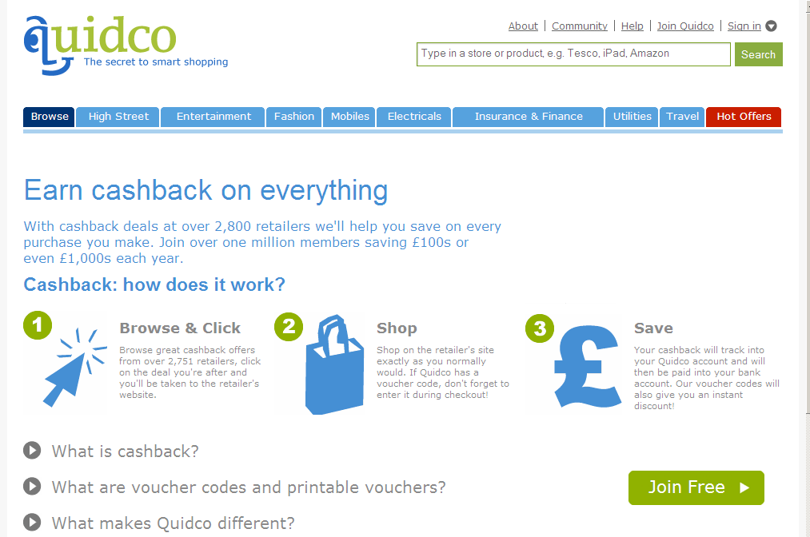
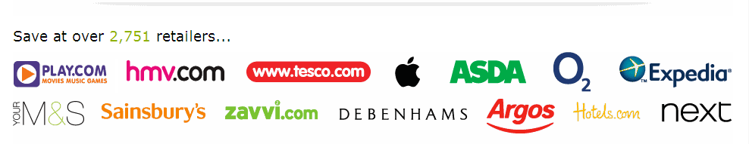
Quidco - Cash back

Slide 16

Greasy palm - Cashback

Slide 17
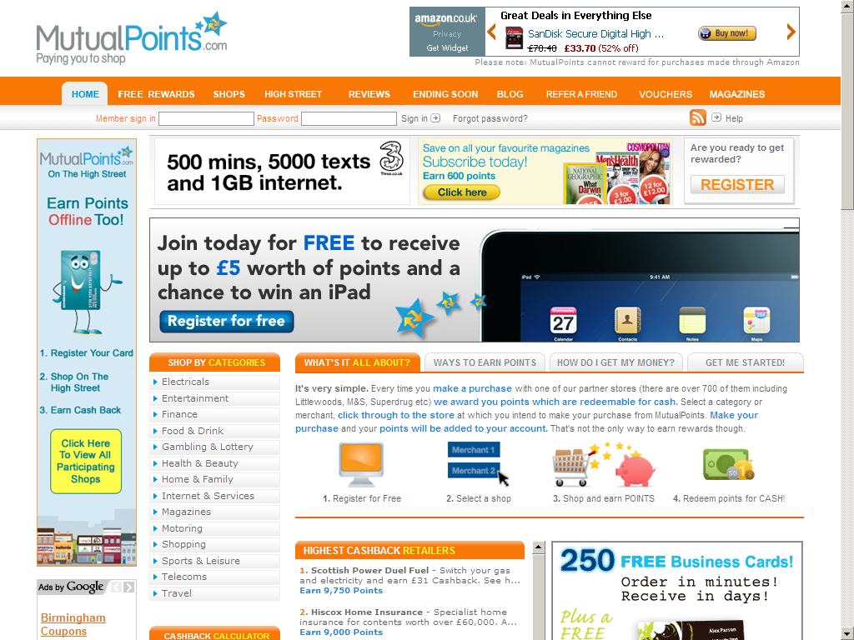
Mutual points - Earn points

Slide 18
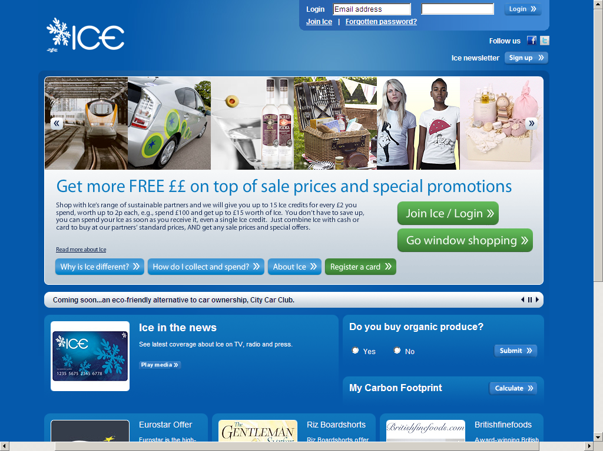
MyIce – online and offline points

Slide 19
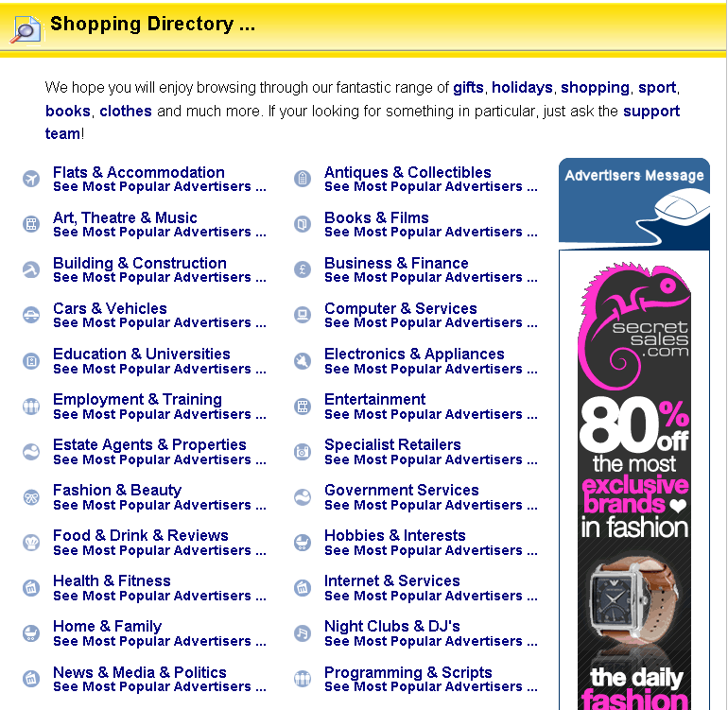
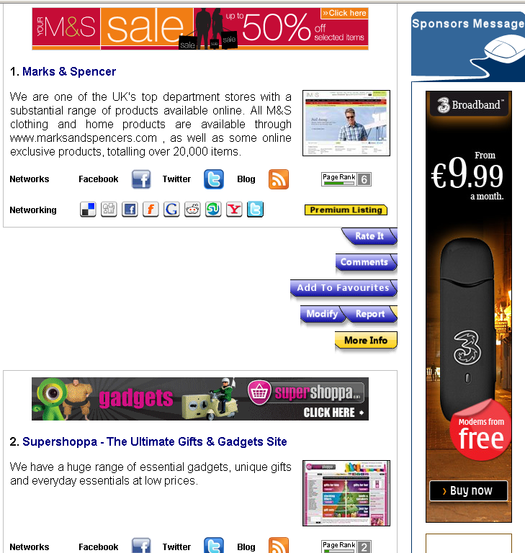
Shopping directory

Slide 20
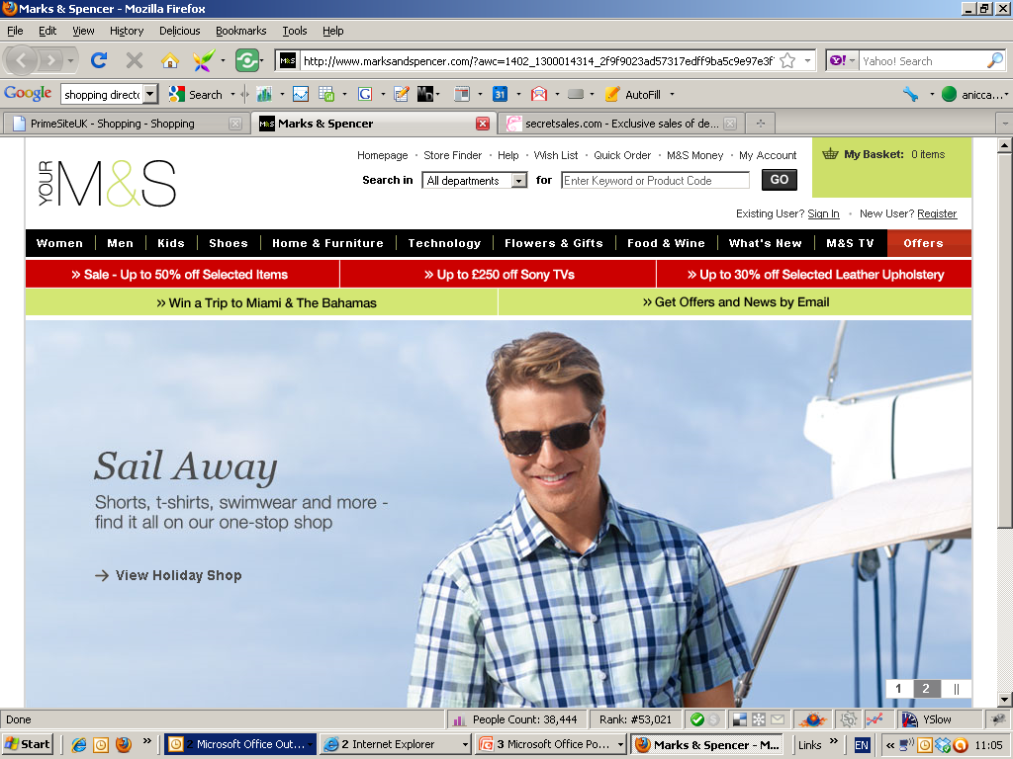
Click through to M & S
(note url has tracking code added)

Slide 21
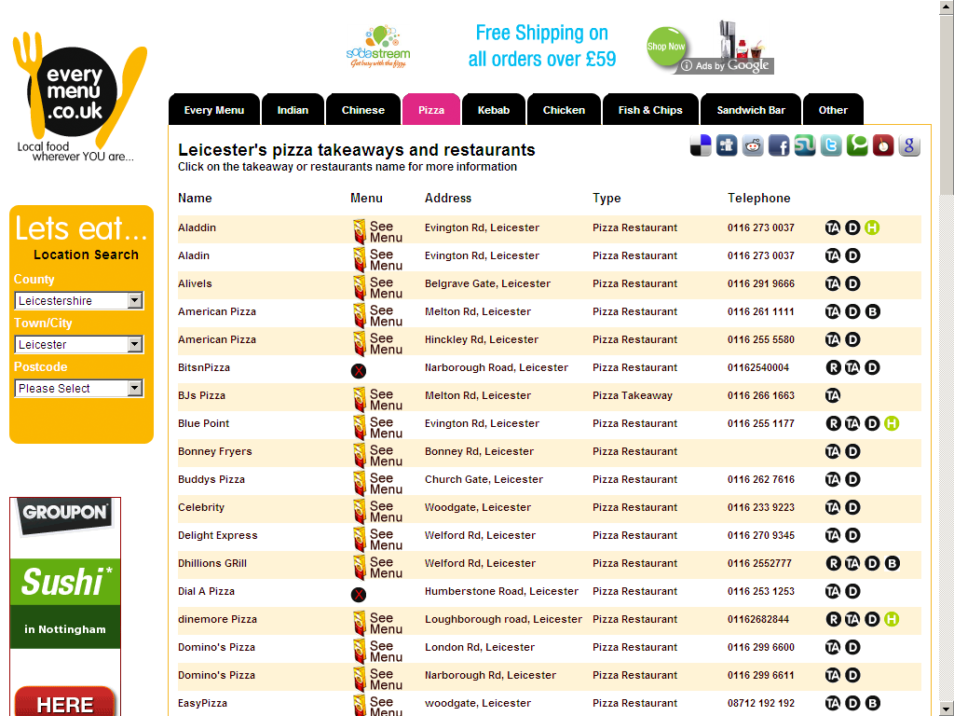
AdSense from Google (not an affiliate ad)

Slide 22
Setting up an affiliate programme
Setting up an affiliate programme

Slide 23
Key elements
Having a programme and commission structure in place to attract affiliates
Getting enough affiliates to join your programme
Ability to track which affiliate generated a successful sale or lead
Easy to manage the programme and pay the affiliates
Ability to reject sales or leads if they are fraudulent or payment is not received

Slide 24
How does it work?
Tracking
Software
Goes
through
Clicks on
Redirects
to
Visitor
Affiliate
Website
Sends
commission
Merchant Site

Slide 25
DIY management
Set-up your own programme
Invest in third party tracking software
Market and recruit your own affiliates
Manage your programme yourself (or recruit an agency)

Slide 26
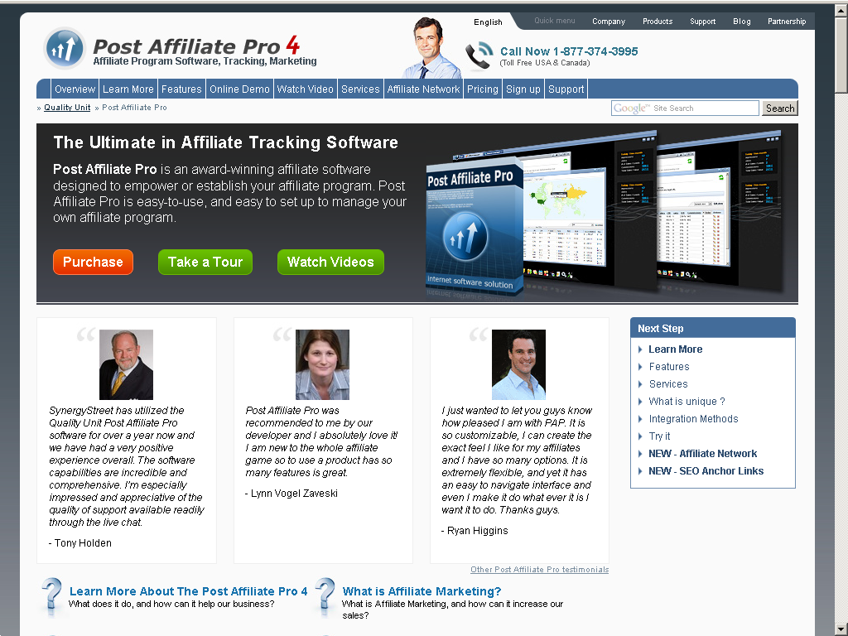
Example of affiliate software

Slide 27
Using an affiliate network
Create your own programme on the network
Use network’s tracking software
Let the network promote and recruit your affiliates
Let the network manage all the payments
Use networks tools to manage the programme
  do this yourself
  use networks in-house services (managed service)
  recruit an agency

Slide 28
Advantages and disadvantages
 | Advantages | Disadvantages
DIY – using tracking software | No network fees You are in control Best for larger companies with lots of experience and resources | Time and skills to set-up scheme Cost of promoting and recruiting affiliates Managing payments yourself
Using an affiliate network | Quick set-up Easy to use All affiliates and marketing in place Payments made through network | Cost of joining network Over-rider commission to network Monthly fee to network Links benefit to network - not you
For small businesses or first time users –
consider using an affiliate network

Slide 29





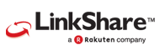



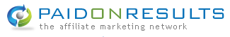


Affiliate networks

Slide 30
Affiliate networks – how they work?
A Merchant registers with an affiliate network and adds their details/programme to the site.
The programme is advertised to the affiliates registered on the network
Affiliates can choose to subscribe to the programmes offered and adds the banner or text ad to their own site
The affiliate generates traffic or leads for the Merchant
Notes:
A Merchant (someone who wants visitors to come to their site to increase sales, leads etc.) registers with an Affiliate provider and adds a programme to the site.
A programme is a combination of a banner or text, an offer of commission, and a link to the Merchant’s site.
An Affiliate (someone who wants to add adverts to their site to generate revenue) also registers with affiliate provider, and subscribes to the programme offered by the Merchant.
This generates code which the Affiliate adds to their site.
Using this code, tracks visitors to the Affiliate’s site and tracks visits from this site to the Merchant’s site. It also records whether the offer conditions are met.
All the data is processed and then credits the Affiliate with the relevant amount of commission.

Slide 31
Affiliate networks – how they work?
Sales or leads are tracked through a combination of tracking code on the Merchant’s website and cookies added to the visitors computer
The Merchant pays a price per lead or commission for each lead or sale (via the network)
The network makes all the payments to the affiliates
Notes:
A Merchant (someone who wants visitors to come to their site to increase sales, leads etc.) registers with an Affiliate provider and adds a programme to the site.
A programme is a combination of a banner or text, an offer of commission, and a link to the Merchant’s site.
An Affiliate (someone who wants to add adverts to their site to generate revenue) also registers with affiliate provider, and subscribes to the programme offered by the Merchant.
This generates code which the Affiliate adds to their site.
Using this code, tracks visitors to the Affiliate’s site and tracks visits from this site to the Merchant’s site. It also records whether the offer conditions are met.
All the data is processed and then credits the Affiliate with the relevant amount of commission.

Slide 32
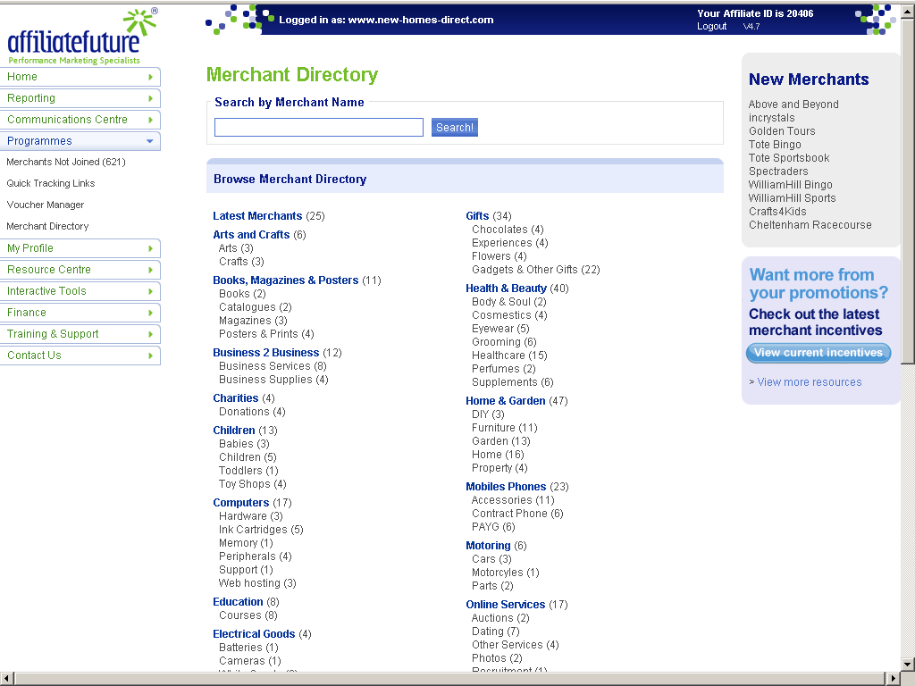
Viewing the Merchant directory

Slide 33
Choosing an affiliate network
  Set-up costs
  Monthly costs
  % over-rider (commission paid to network)
  Number of UK affiliates
  Experience of Merchants similar to you
  Ease of use of interface
  Minimum contract period
  Other conditions and costs

Slide 34
Preparing your campaign
Apply for an account
Pay deposit/set-up fee
Prepare your programme for affiliates
  Provide description of company and website with average sales and order size
  Commissions offered (and/or cost per leads)
  Bonuses and additional commission tiers for affiliates hitting certain targets
  Restrictions e.g. PPC advertising on brand name
  Text and creative (banners and buttons) to be used on affiliate sites
Add tracking code to your site and possibly create a different landing page
Run test and then make live

Slide 35
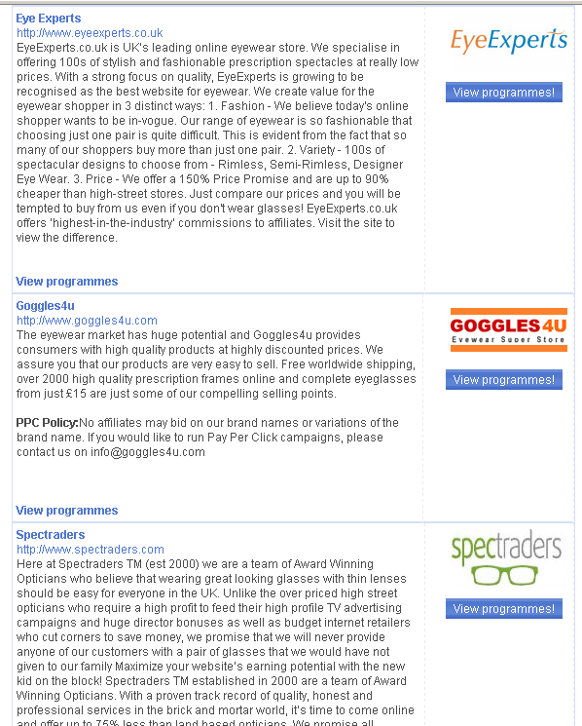
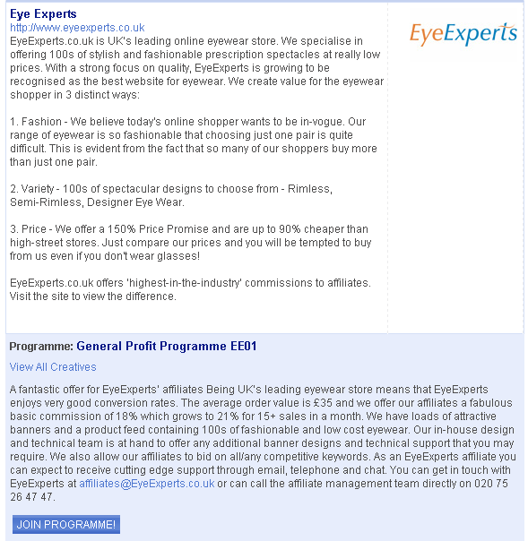
Programme for selling products - example

Slide 36
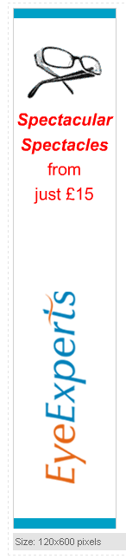
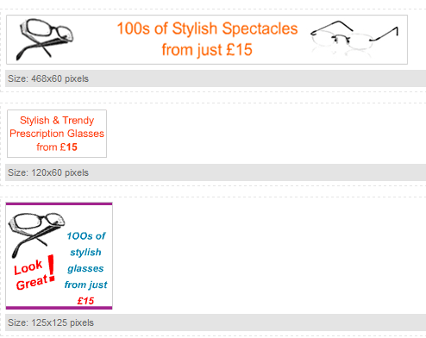
Creative

Slide 37
Managing your campaign
Monitor daily and check all sales/leads – reject bogus sales/leads
Reject unsuitable affiliates
Offer monthly promotions and bonuses to increase take-up and sales
Top up your account with your credit card

Slide 38
Likely results
Expect up to 300 affiliates to sign up for a campaign within the first month
This will increase gradually over 6 months
Most sales will come from a handful of sites (super-affiliates)
You could receive up to a third of your traffic and sales from these sites (seen as referral traffic in Analytics)

Slide 39
Improving your results
It is essential to monitor daily for bogus leads or sales (you have up to 5 days to reject)
Your commission has to be attractive for affiliates to bother to market your product/service, so compare yourself with similar programmes
Offer multiple tiers, bonuses and competitions
Police your affiliates especially if they are “stealing” your PPC traffic

Slide 40
Costs and commissions
 | Lower | Upper
Commission to affiliate (sector and Merchant specific) | 5% £1 cost per lead | 25% £50 cost per lead Multiple tiers and bonuses for selling certain targets
Over-rider commission (paid to network) | 25% of commission paid to affiliates (e.g. 12% to affiliates 3% to network) | 30% of commission paid to affiliates (e.g. 12% to affiliates 4% to network)
Set-up fee | Free e.g. Profitistic | £1500 - £2000 (larger networks with more affiliates)
Monthly fee – DIY (sometimes over-rider is deducted from this) | Free e.g. Profitistic | DIY - £75-£150 per month
Monthly fee - managed | £250/month | Up to £850/month
Entry criteria | None | Minimum monthly sales

Slide 41
Product feed or syndication
Product feed or syndication

Slide 42
What is “product feed” or syndication
Where products details from one ecommerce database are fed into and displayed in other websites, directories or shopping platforms
The technology is used for many different types of POP marketing techniques including:
  Product syndications sites with link back to seller’s site (paid commission on sale)
  Ecommerce sites with drop shipping (paid commission on sale)
  Market places with drop shipping/commission on sale

Slide 43
What is “product feed” or syndication
It is also used for other marketing types, including;
    Google Merchant Centre and Bing shopping results (free display of your products),
  eBay (pay on display and commission on sale)
  Shopping comparison sites (pay per click)

Slide 44
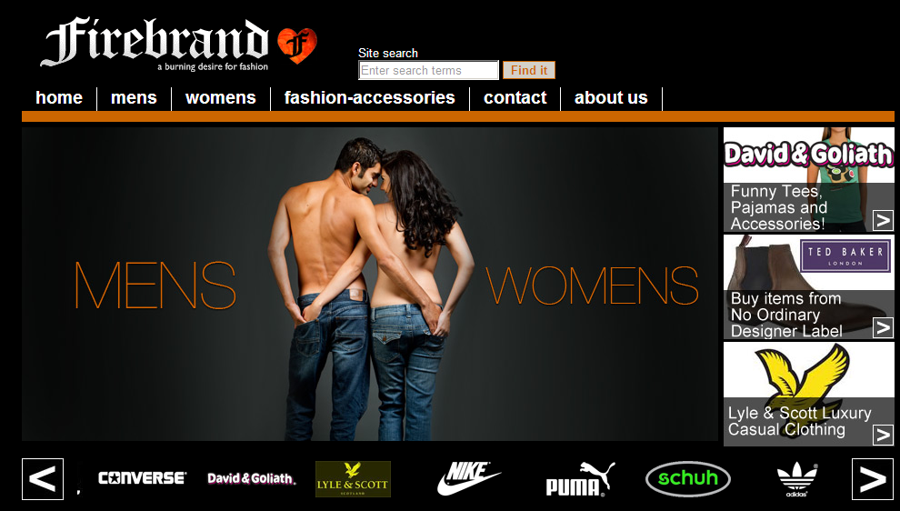
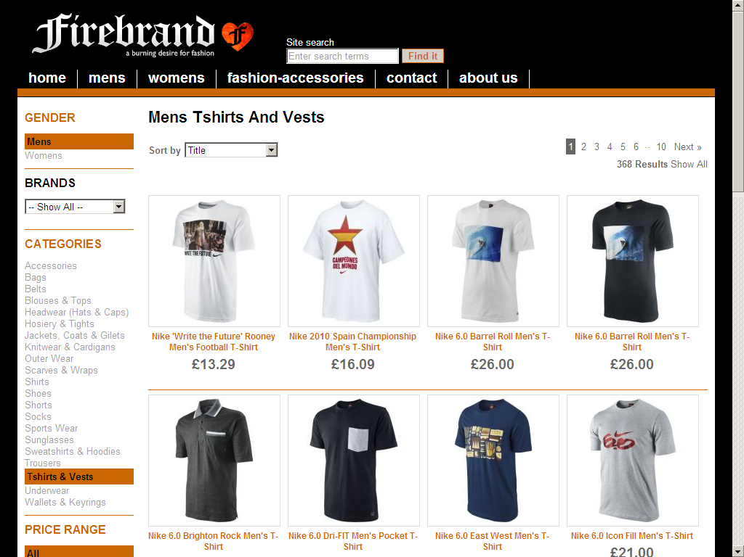
Examples of affiliate product feed sites

Slide 45
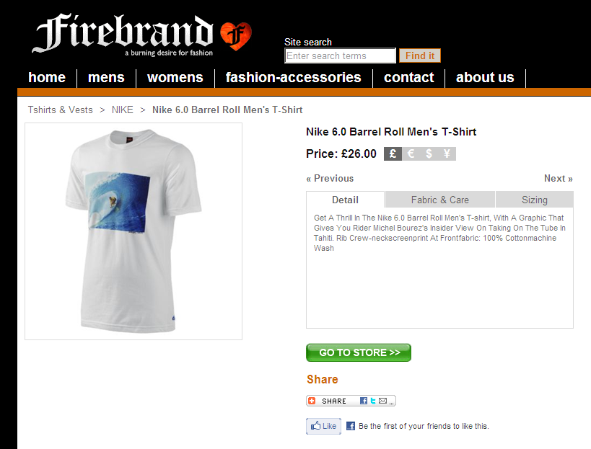
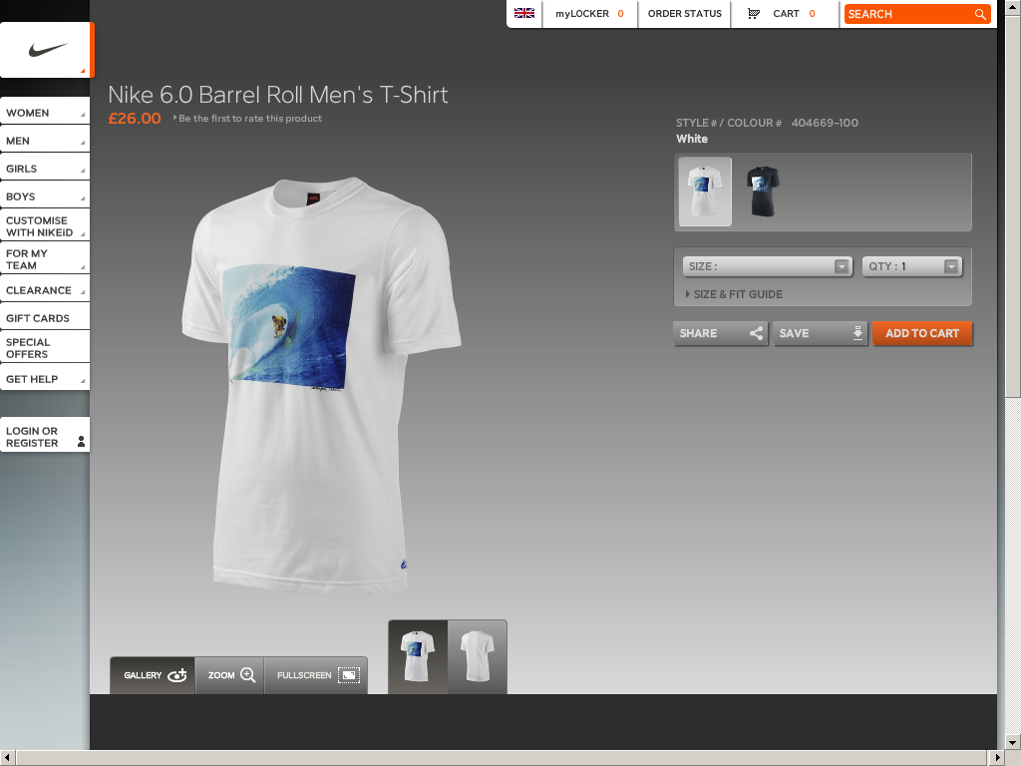
Examples of affiliate product feed sites

Slide 46
Product syndication
Product syndication websites are normally produced by web developers or more technical businesses
The website can be populated with a product feed directly from the seller or via an affiliate network
The website may consolidate feeds from a number of sources and consequently display many brands or manufacturers for a certain product range or sector
The user sees a typical ecommerce site but instead of adding a product to a basket they are redirected to the product page on the sellers site to buy

Slide 47
Generating the feed
Normally in the form of an xml or csv file
Can be automatically generated through plug-ins
Your developer may have to produce the feed for bespoke and some ecommerce platforms
Once generated can be re-used, e.g. you can sign up to certain affiliate network and allow their affiliates to use your feed to populate their websites
The feed required for some platforms may vary, for example Amazon requires bar-code numbers

Slide 48
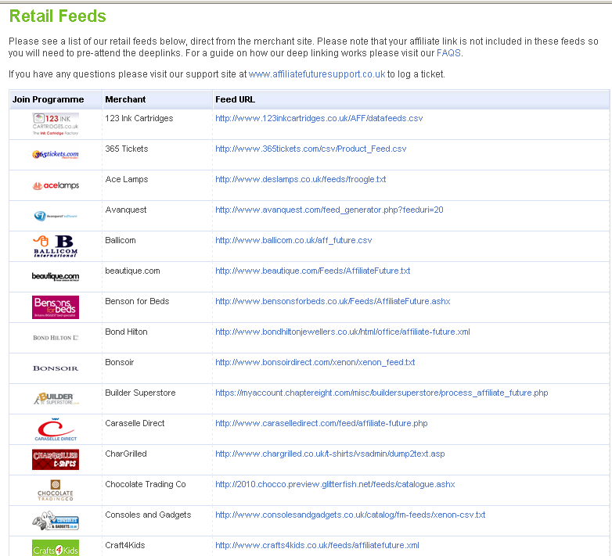
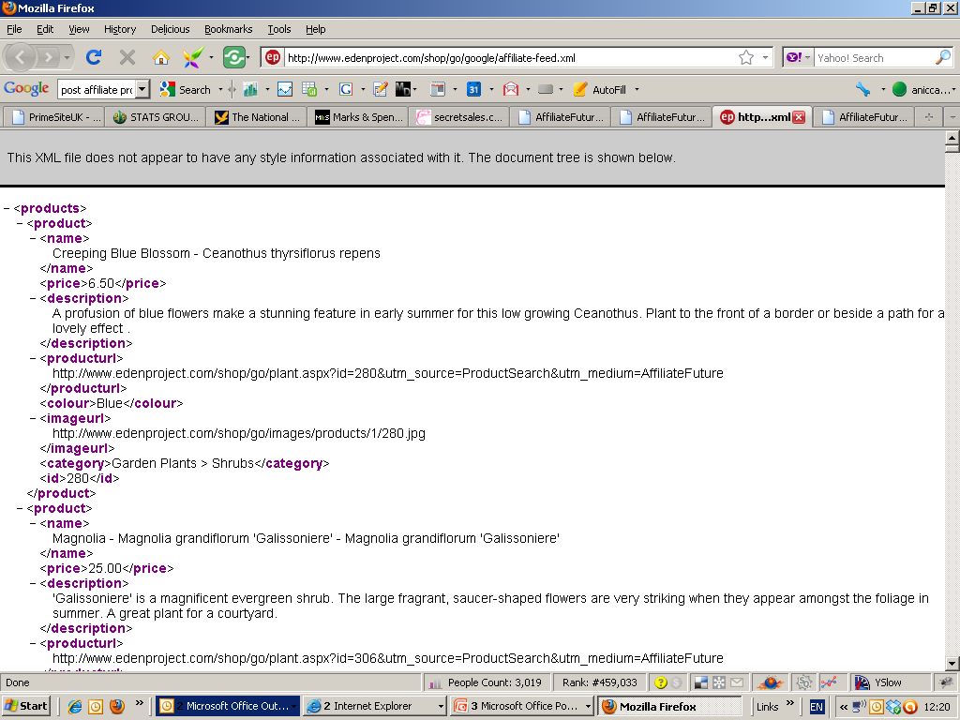
Affiliate network feeds

Slide 49
money taken on affiliate’s site but no stock held
Drop shipping and market places

Slide 50
Drop shipping
Drop shipping comes in a number of forms:
  Small businesses acting as sellers of your product
  “White label websites”
  Market places
The drop shipping company acts as a marketing agent but does not hold any stock
The website appears as a normal ecommerce website

Slide 51
Drop shipping - cont.
  Payments are taken on the site from the buyer
  The identity of the supplier is not always displayed
The order is sent to merchant or supplier
The supplier sends out the goods directly to the customer – possibly with branded packaging for the advertiser/drop shipper

Slide 52
Merchant – advantages and disadvantages
Advantages
  Increases reach and markets, as other businesses carry out the marketing on your behalf
  Relatively low set-up costs – although there may be a set-up or joining fee
  Easy to administer – you receive email when a sale is made, so you can dispatch the goods
Disadvantages
  Need to find marketing platforms or recruit drop shippers
  Lack of control – you do not take the money and may have to wait for payments
  Who is responsible for returns?

Slide 53
Drop shipper – advantages and disadvantages
Advantages
  Low cost and low risk business model
  You don’t have to buy any stock
  Ready made white label websites and “business in a box” can be bought for a few hundred pounds
Disadvantages
  High level of knowledge in online marketing needed to drive traffic and sales to your new website
  You incur all the marketing costs
  Some products have low margins e.g. ink cartridges and you could spend more on acquiring a sale then you will receive
  Lack of control over prices and supplier

Slide 54
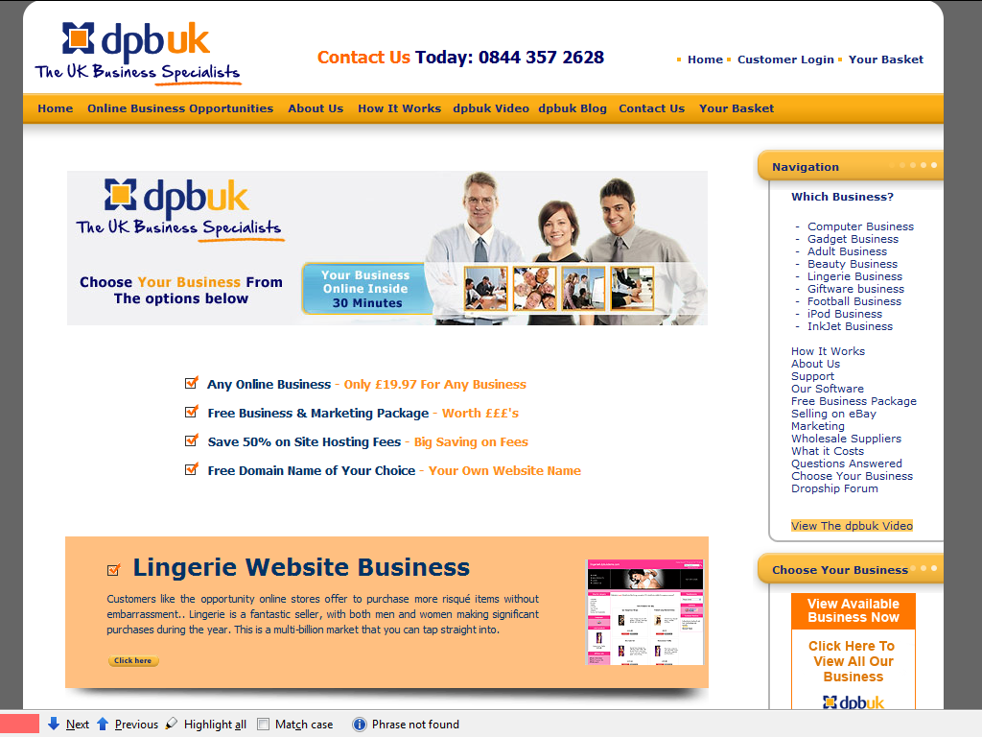
Start your own drop shipping business

Slide 55
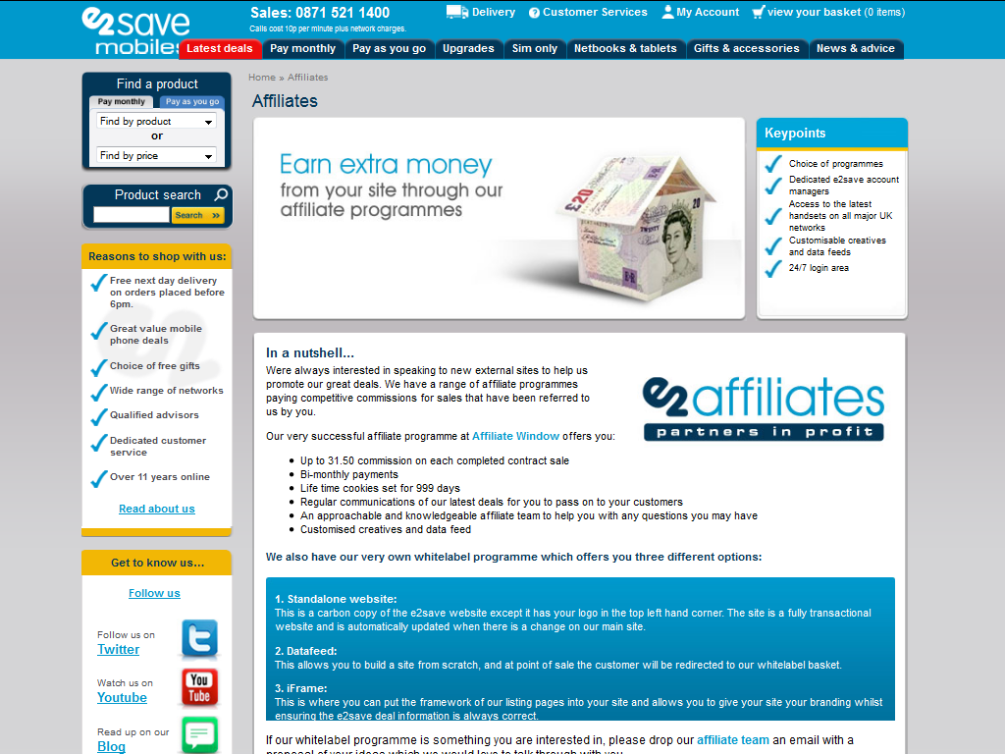
Car Phone Warehouse – white label sites

Slide 56
Market places
Market places

Slide 57
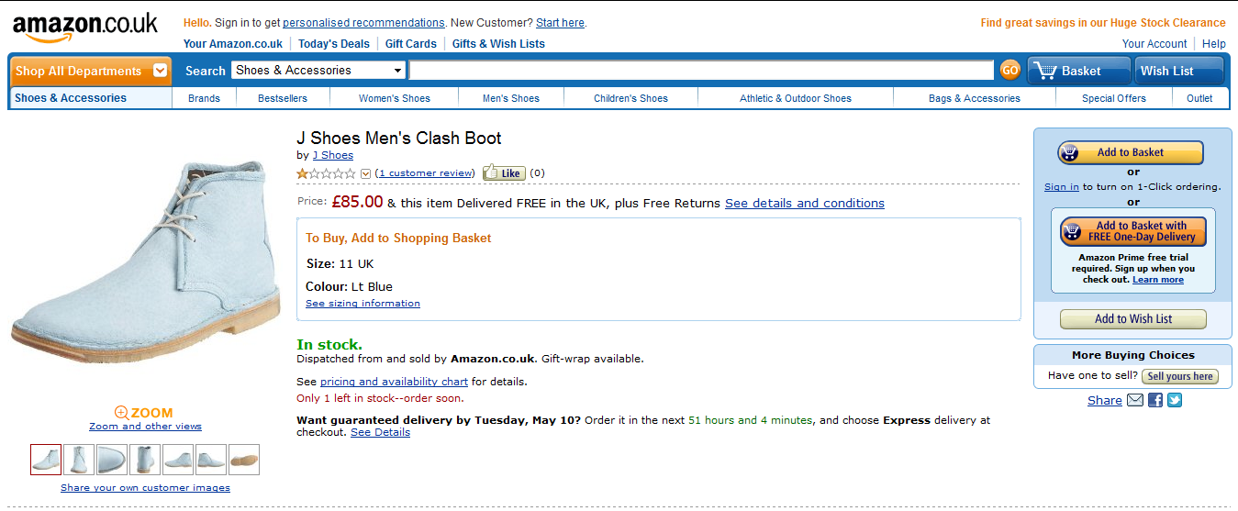
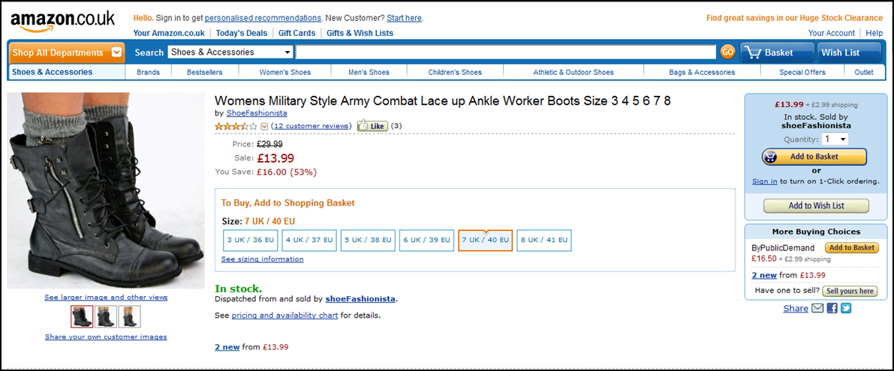
Amazon – stock held vs drop shipping

Slide 58
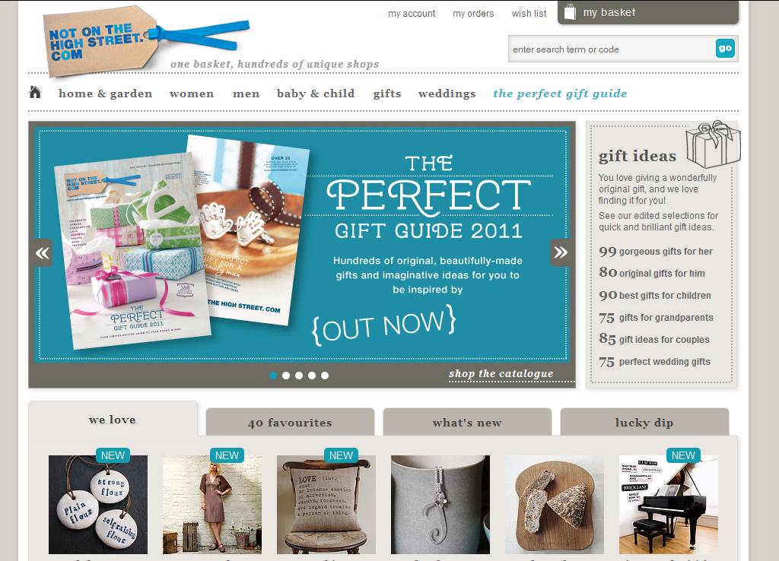
Not On The High Street.com

Slide 59
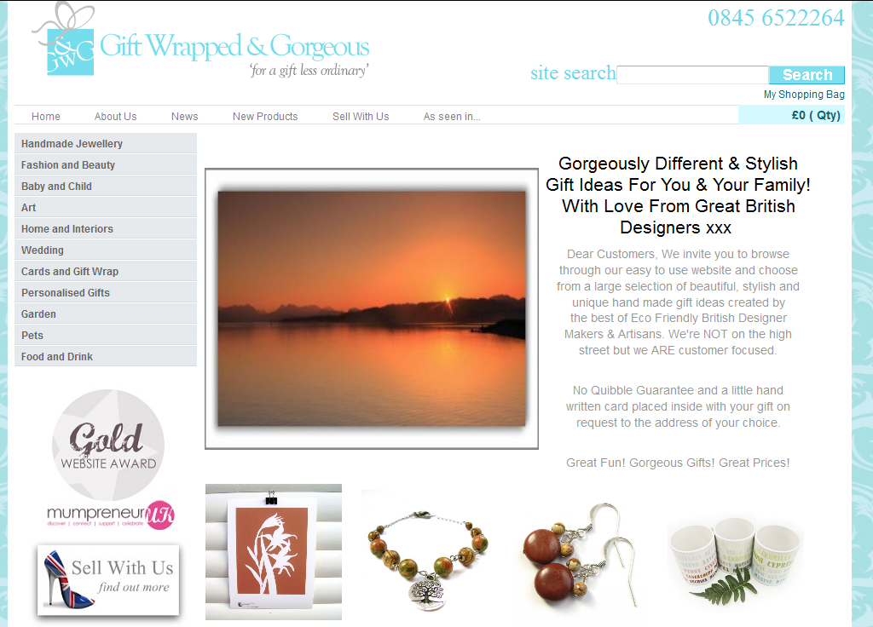
Gift Wrapped and Gorgeous.co.uk

Slide 60
Lead generation for services
Lead generation for services

Slide 61
Types of lead generation
Affiliate banners
Get a quote – general business to business services or tradesman
Get a quote - sector or skill specific
Pay for leads – other channels
Pay for sales – specialist sales agents

Slide 62
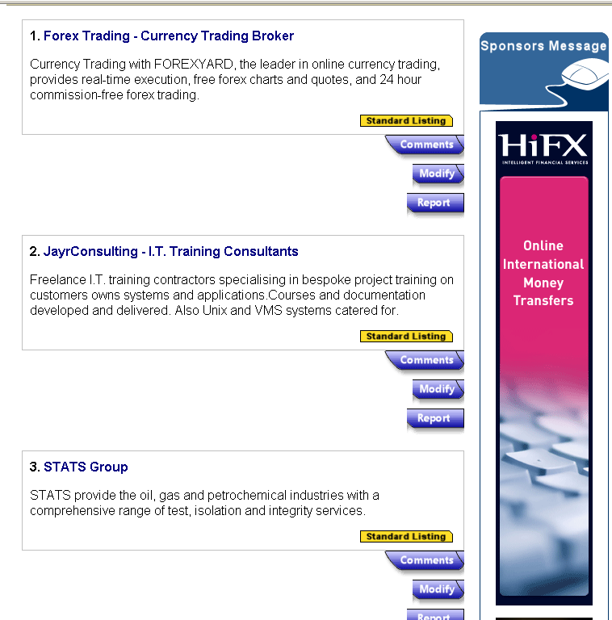
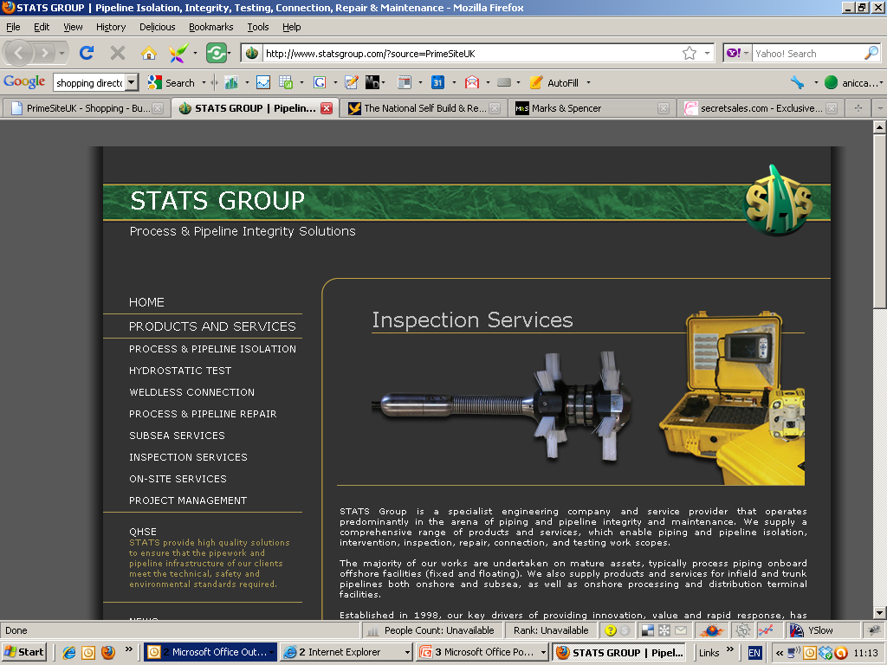
Business to business affiliates banners

Slide 63
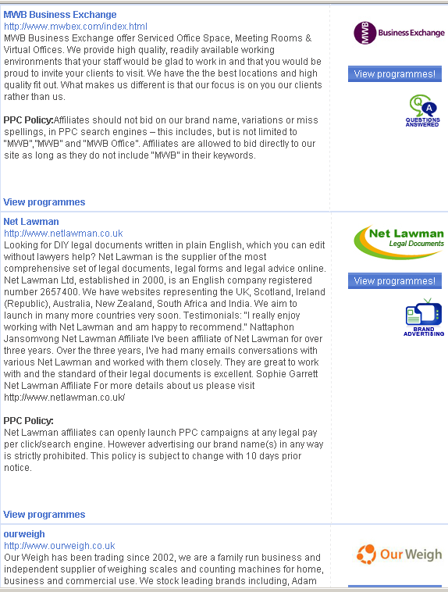
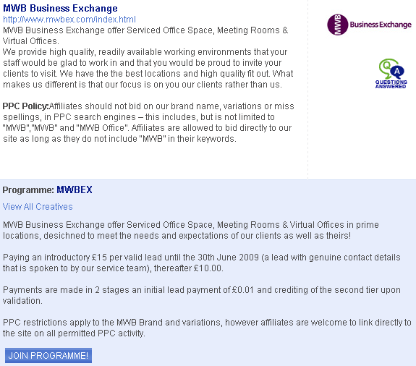
Example of a programme for lead generation

Slide 64
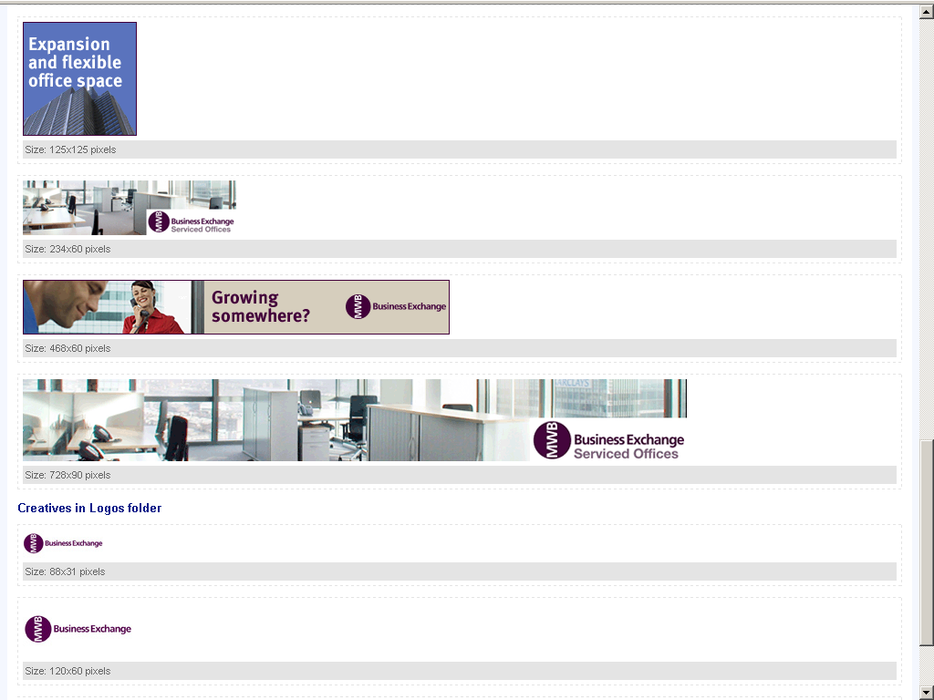
Creative

Slide 65
Quotation sites
The service provider signs up for the lead generation or quoting service
  Business to business all sectors e.g. Approved Index, Campaneo
  Tradesman sites e.g. Service Magic, MyHammer
  Sector or skill specific e.g. Choose Your accountant, Solar-Guide
You agree to receive by email a certain number of leads per week, usually by type and location
Leads vary from £5 to >£100 (e.g. for website leads?)

Slide 66
Quotation sites
You either pay online or by invoice
There is often a minimum contract and other conditions
You may also get a listing within their directory
Other directory sites now offer quotes as an added service e.g. Free Index

Slide 67
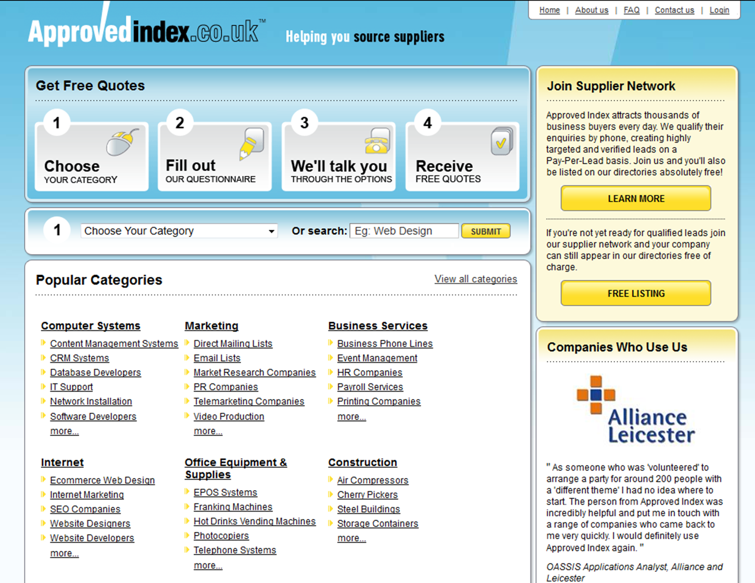
Quotation services – B2B

Slide 68
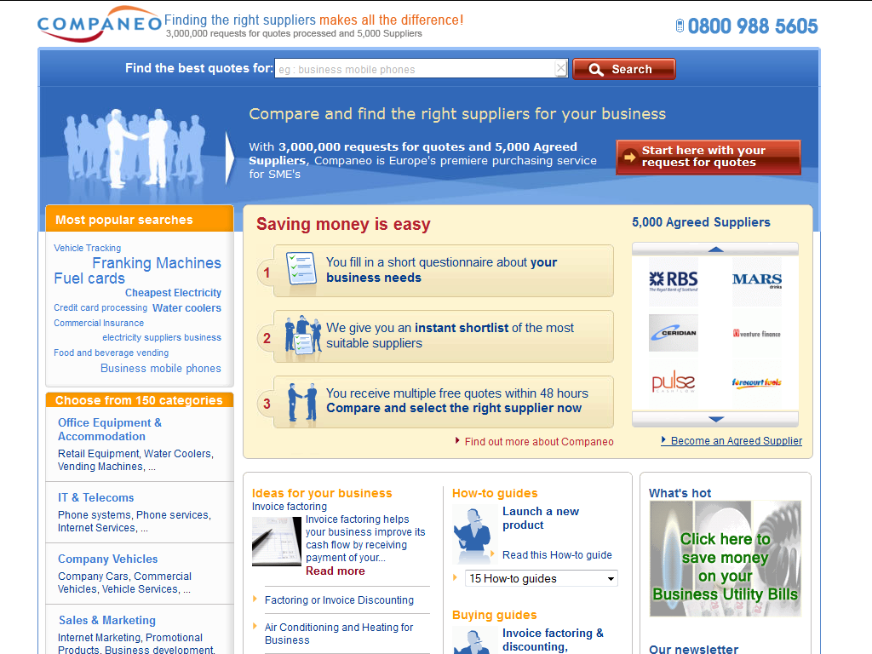
Quotation services – B2B

Slide 69
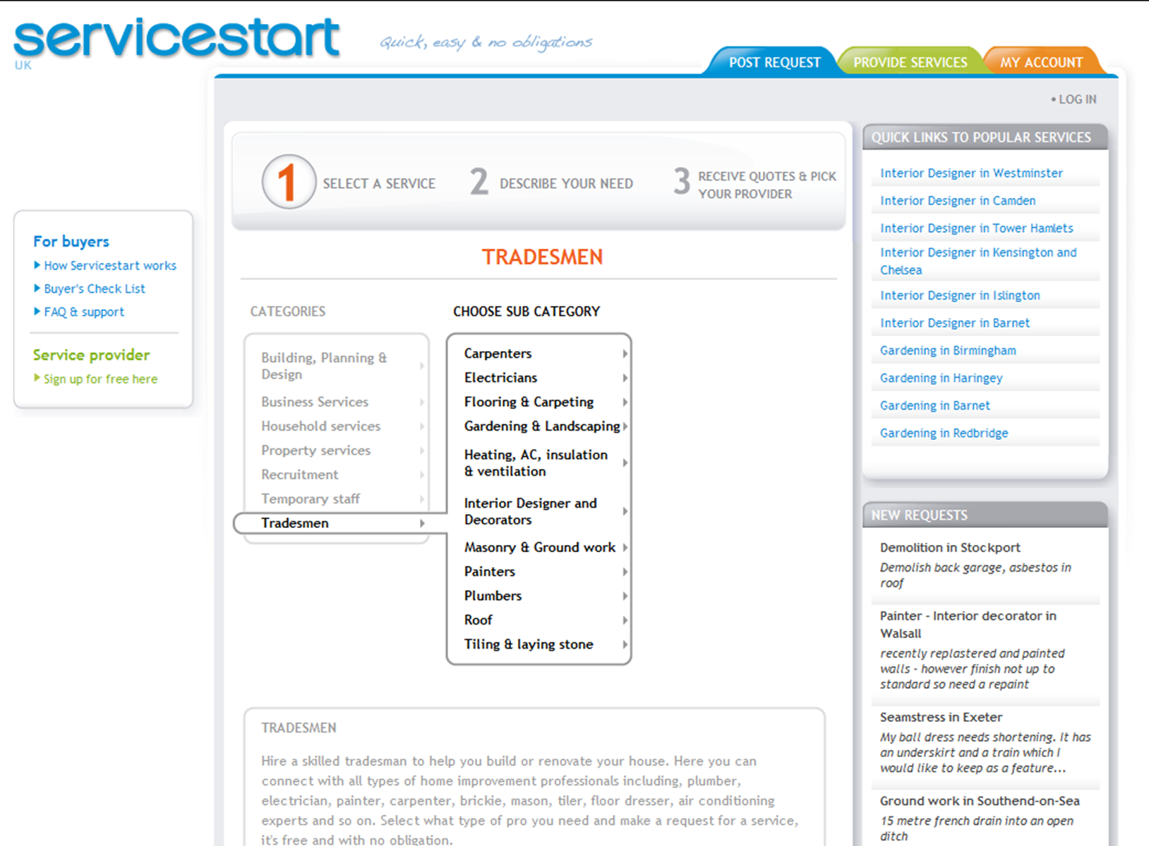
Quotation - tradesman

Slide 70
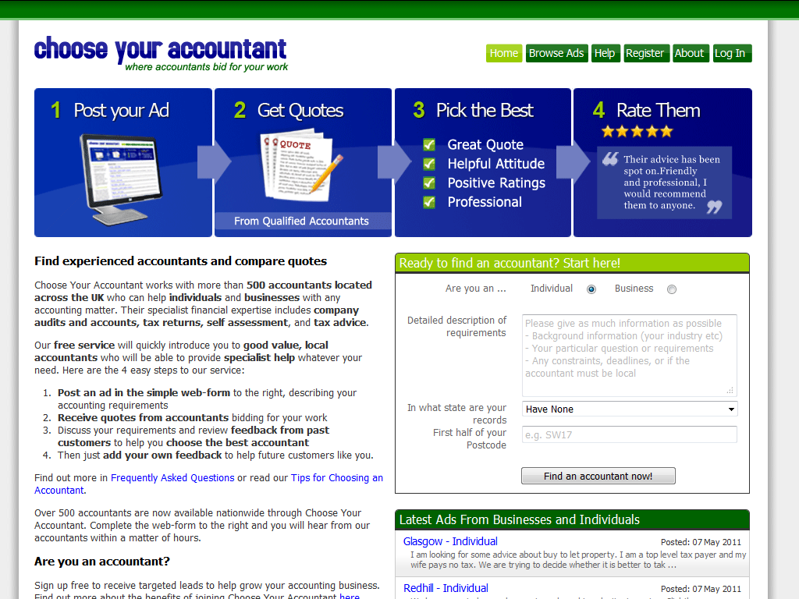
Sector specific quotes

Slide 71
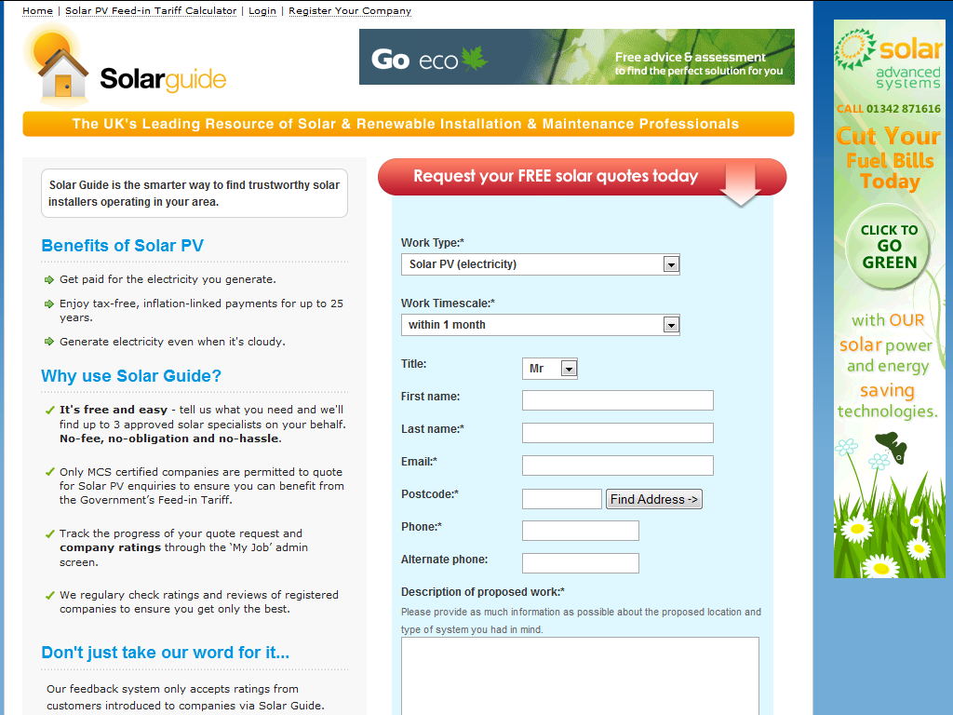
Sector specific quotes

Slide 72
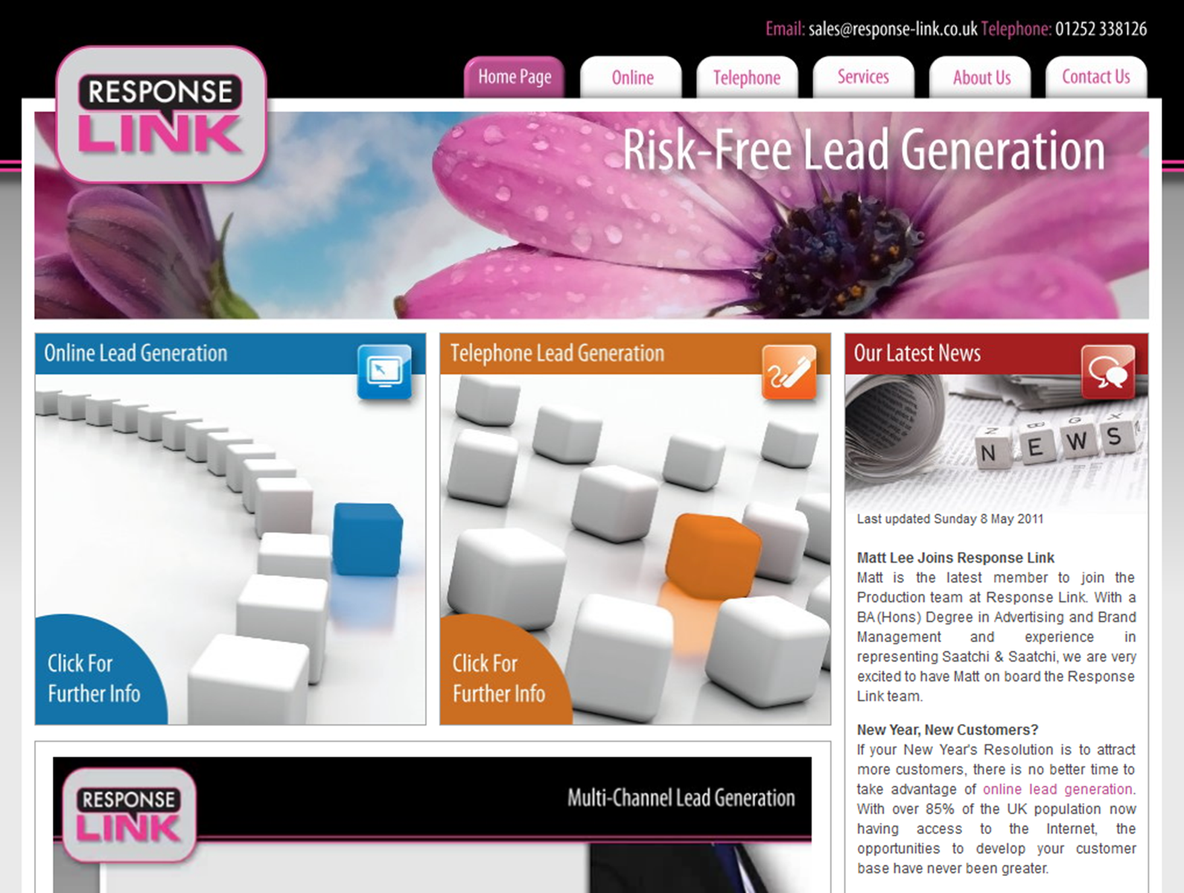
Pay per lead via other channels

Slide 73
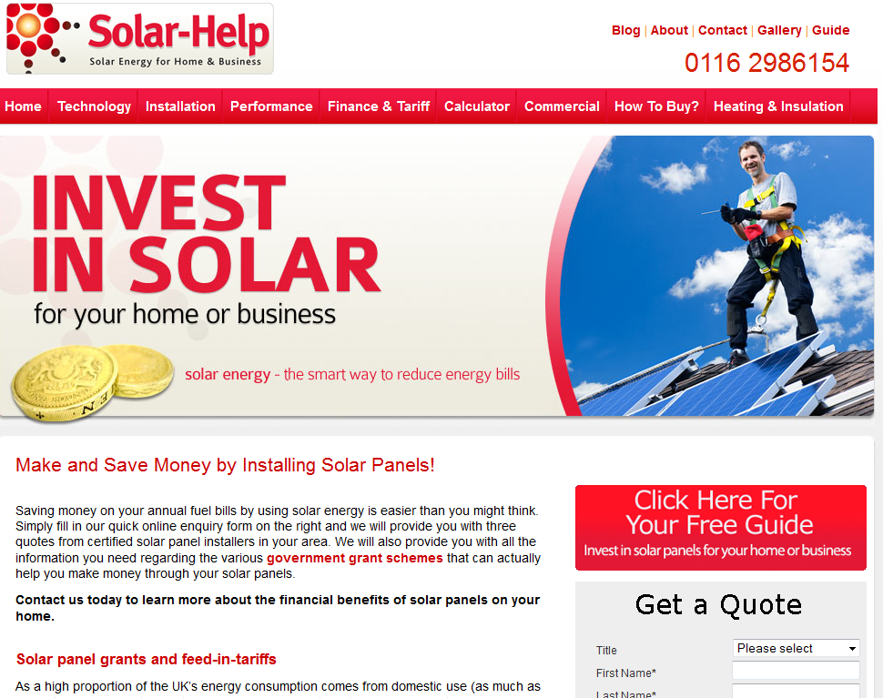
Pay per Sale – outsourced sales and marketing

Slide 74
Daily deal and voucher sites
Daily deal and voucher sites

Slide 75



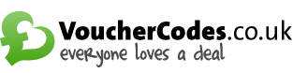
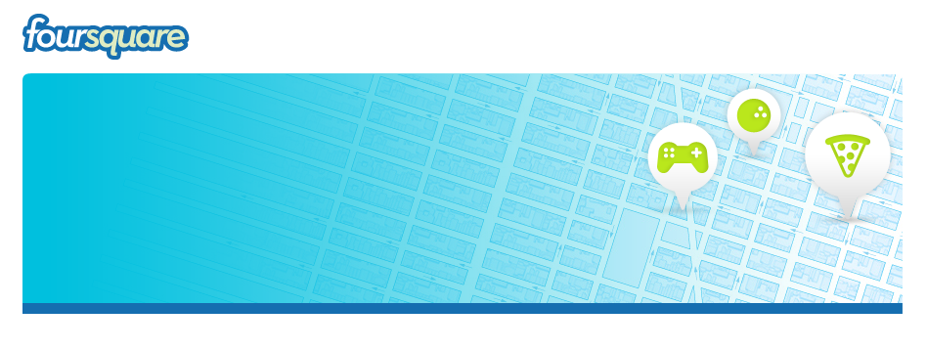
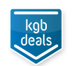




Daily Deals and Voucher Sites

Slide 76
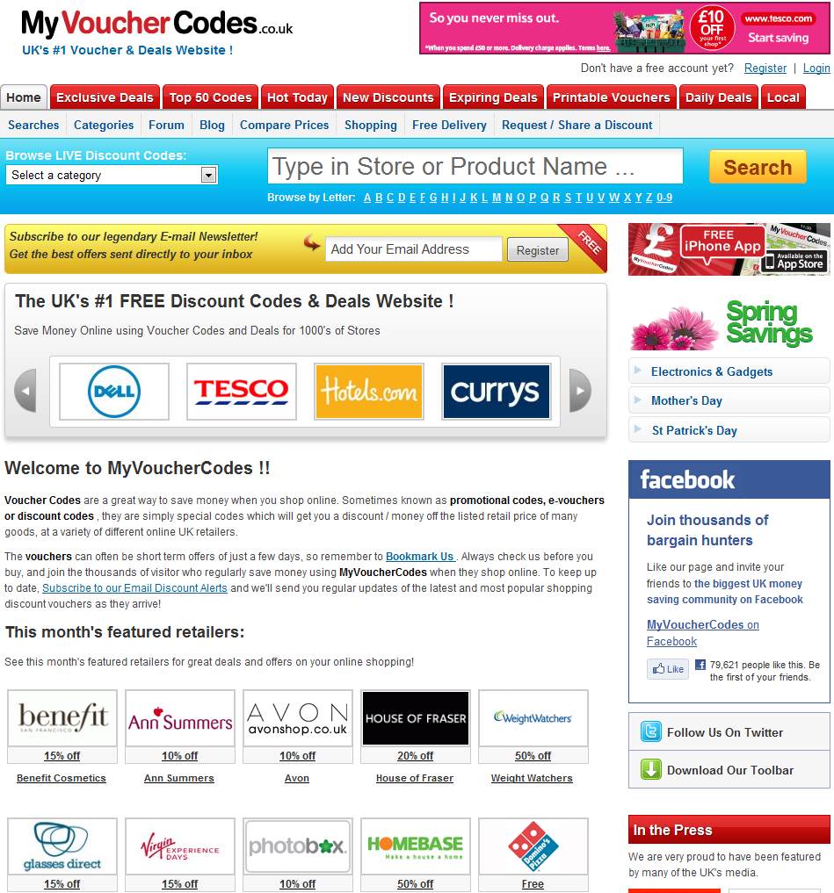
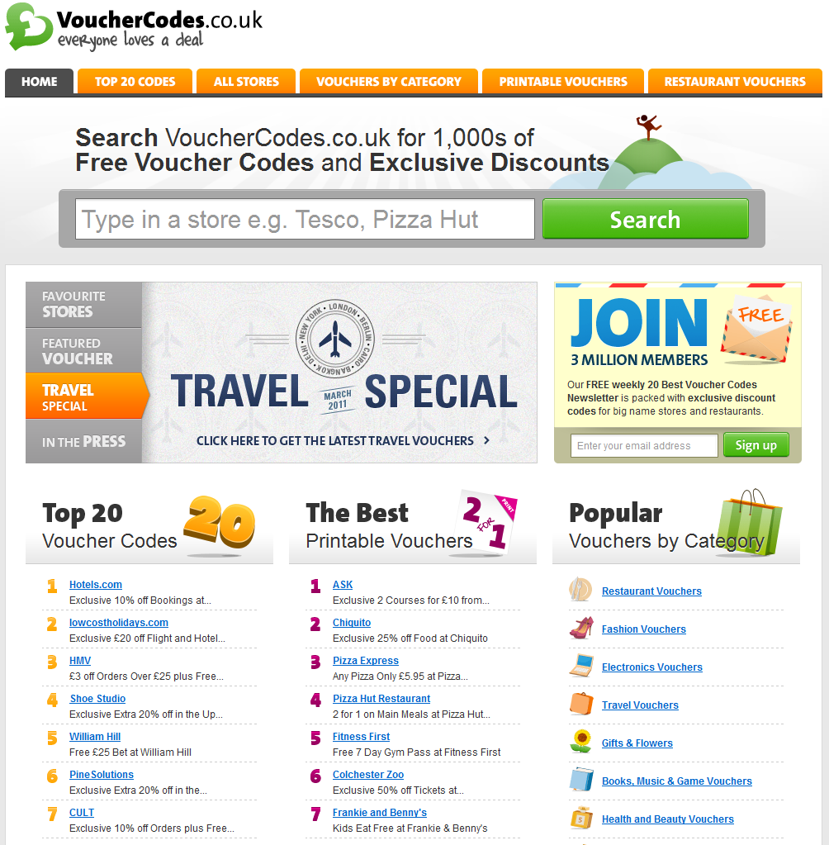
Voucher Codes Websites

Slide 77
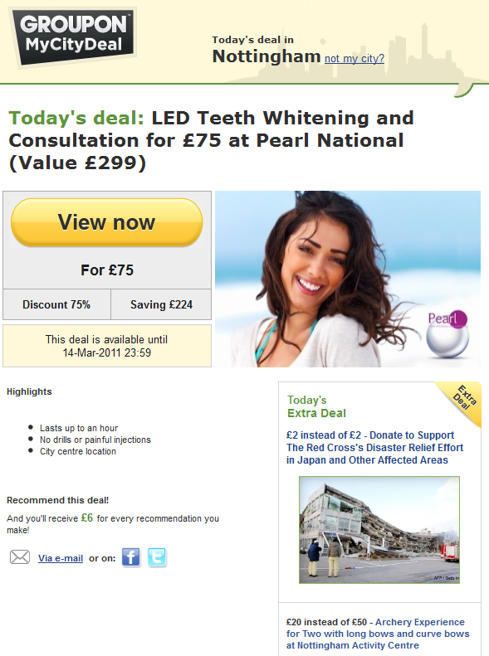

Groupon

Slide 78
Groupon deals
Merchants are mainly local restaurants, beauticians, hotels, entertainment, days out, and other services
Merchant develops a deal with Groupon, which usually has a minimum of 50% discount (for over 50 people)
Groupon advertises the deal to their e-mail data list within the specified location and on their website as a daily deal or “side deal”
Recipients are encouraged to refer the deal to friends to receive cash payment

Slide 79
Groupon deals
A minimum number of customers have to pay for the deal for it to be activated
They then receive a voucher code which they redeem with the Merchant
The Merchant claims 50% of the sale value from Groupon for each customer that redeems their voucher, but loses the income from anyone who does not redeem their voucher
This is best used as a method of free marketing – with the Merchant often relying on repeat business to generate real income

Slide 80
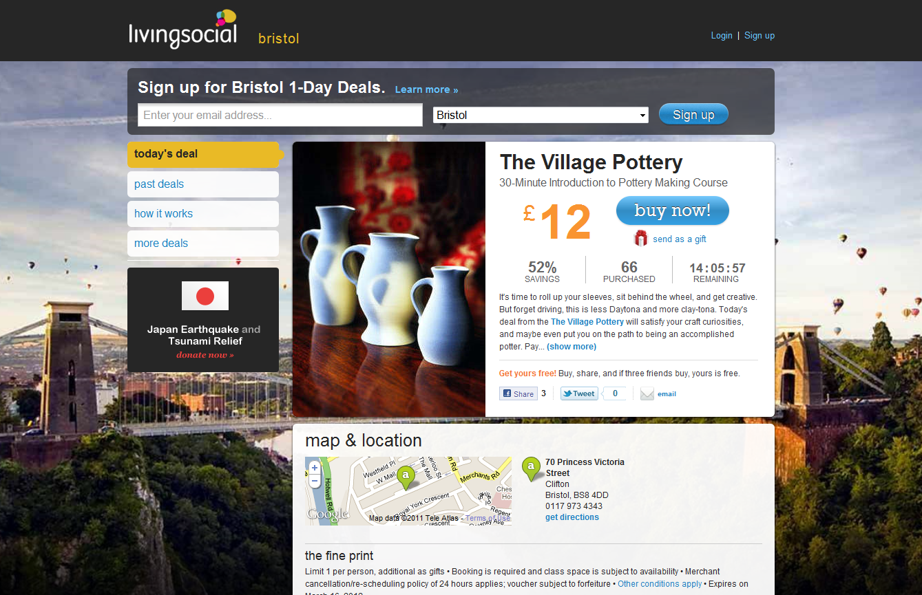

Alternatives to Groupon

Slide 81
Alternatives to Groupon
Lower commission rates
Offers run for a longer duration
Better admin assistance, e.g. you receive all the contact details
Better terms and conditions for Merchants e.g. you get all the money whether they redeem the voucher or not
Main disadvantage is that they have less recipients or members (lower reach)

Slide 82
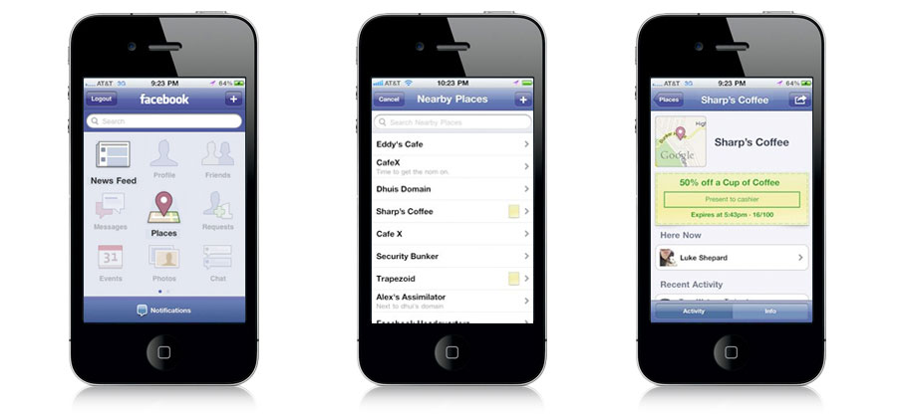




Mobile Based Deals
Customers download an app onto their phone
When they go shopping they check-in and tell their friends where they are
Customers get offered deals direct to their mobile based on their location and the shop they have checked into:
  Facebook allows users to see what deals are available and the terms and conditions
  Foursquare is another emerging mobile site which runs similar offers
  SCVNGR is a new service that includes a gaming element

Slide 83

Thank you
  Any questions?
  Update your evaluation form
  Visit the eBusiness Club website:
    The workshops and events programme
    www.ebusinessclub.biz

